Slide 1
Soft Robotic Arm ROCO504
By
Joshua Sullivan
Alex Rowe
Simon Walker

Slide 2
Introduction and Goals
Develop an arm that
Replicates the movement of a human arm.
Throws a projectile further than if the servos where statically connected to one another.
Uses 3D printer materials, designed on AutoDesk Fusion 360
Is comparable to a human arm.
Notes:
This project looks at soft robotics and how the sudden release of stored energy can help a robot arm throw a ball.
A human arm uses antagonistic muscle pairs to throw a projectile, we aim to replicate this with our robotic arm. This will allow the robotic arm to throw a projectile further than the servos could if in a direct drive system.
This is desirable as typically larger servos would be required that cost more, weigh more and take up a larger amount of space.

Slide 3
Requirements
Throw a projectile further than with direct drive servos.
Utilise energy storage from tendons.
Replicate the design and motion of a human arm.
Movement constrained to that of a human arm.
Cover at least 4 of the following topics:
CAD (e.g. Autodesk Fusion 360)
CAM (e.g. 3D printing)
Finite Element Analysis (FEA)
Tensile/hardness testing
Agonist-antagonist joints
Soft mechanisms and materials
Embodied artificial intelligence

Slide 4
Human Movement and Function Laboratory (HMFL)
Notes:
Medical school
Booked meeting
Study human arm
Study robot arm

Slide 5
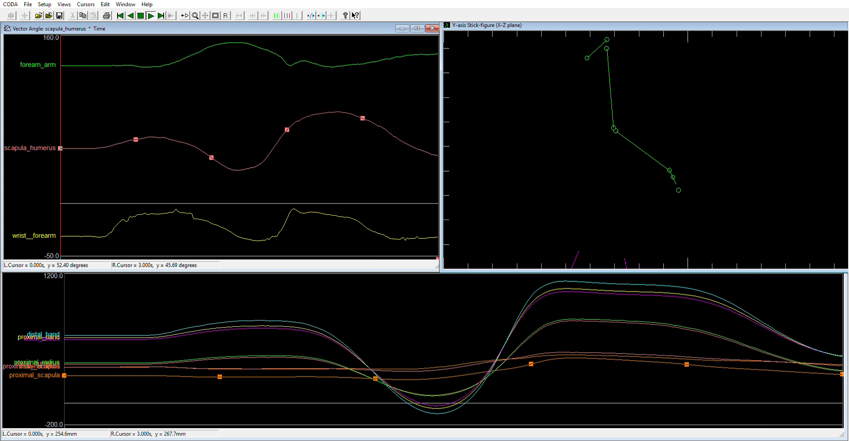

Slide 6
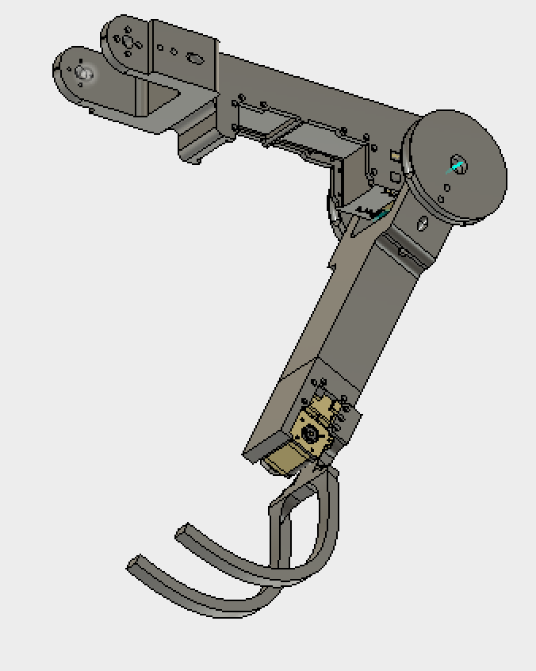
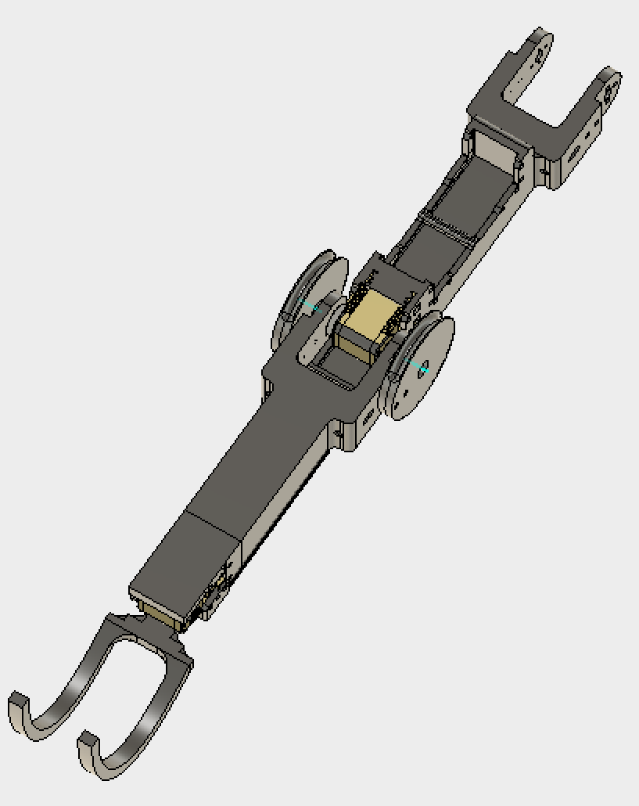
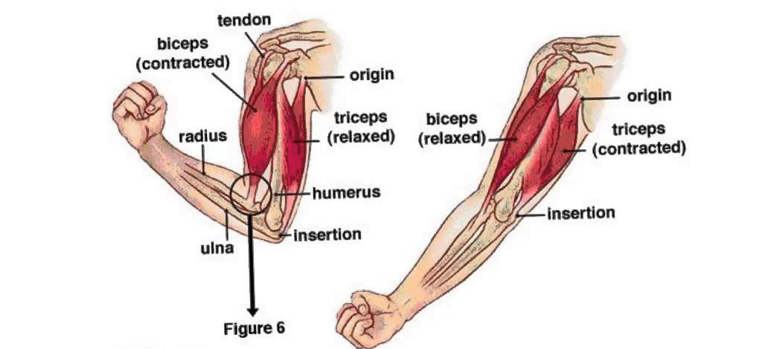
Antagonistic Joint Control
The Arm will use antagonistic muscle pairs that work opposing to each other to control the movement at the shoulder and elbow joint.
Notes:
Antagonisitc muscle pair
One contracts
One relaxes

Slide 7
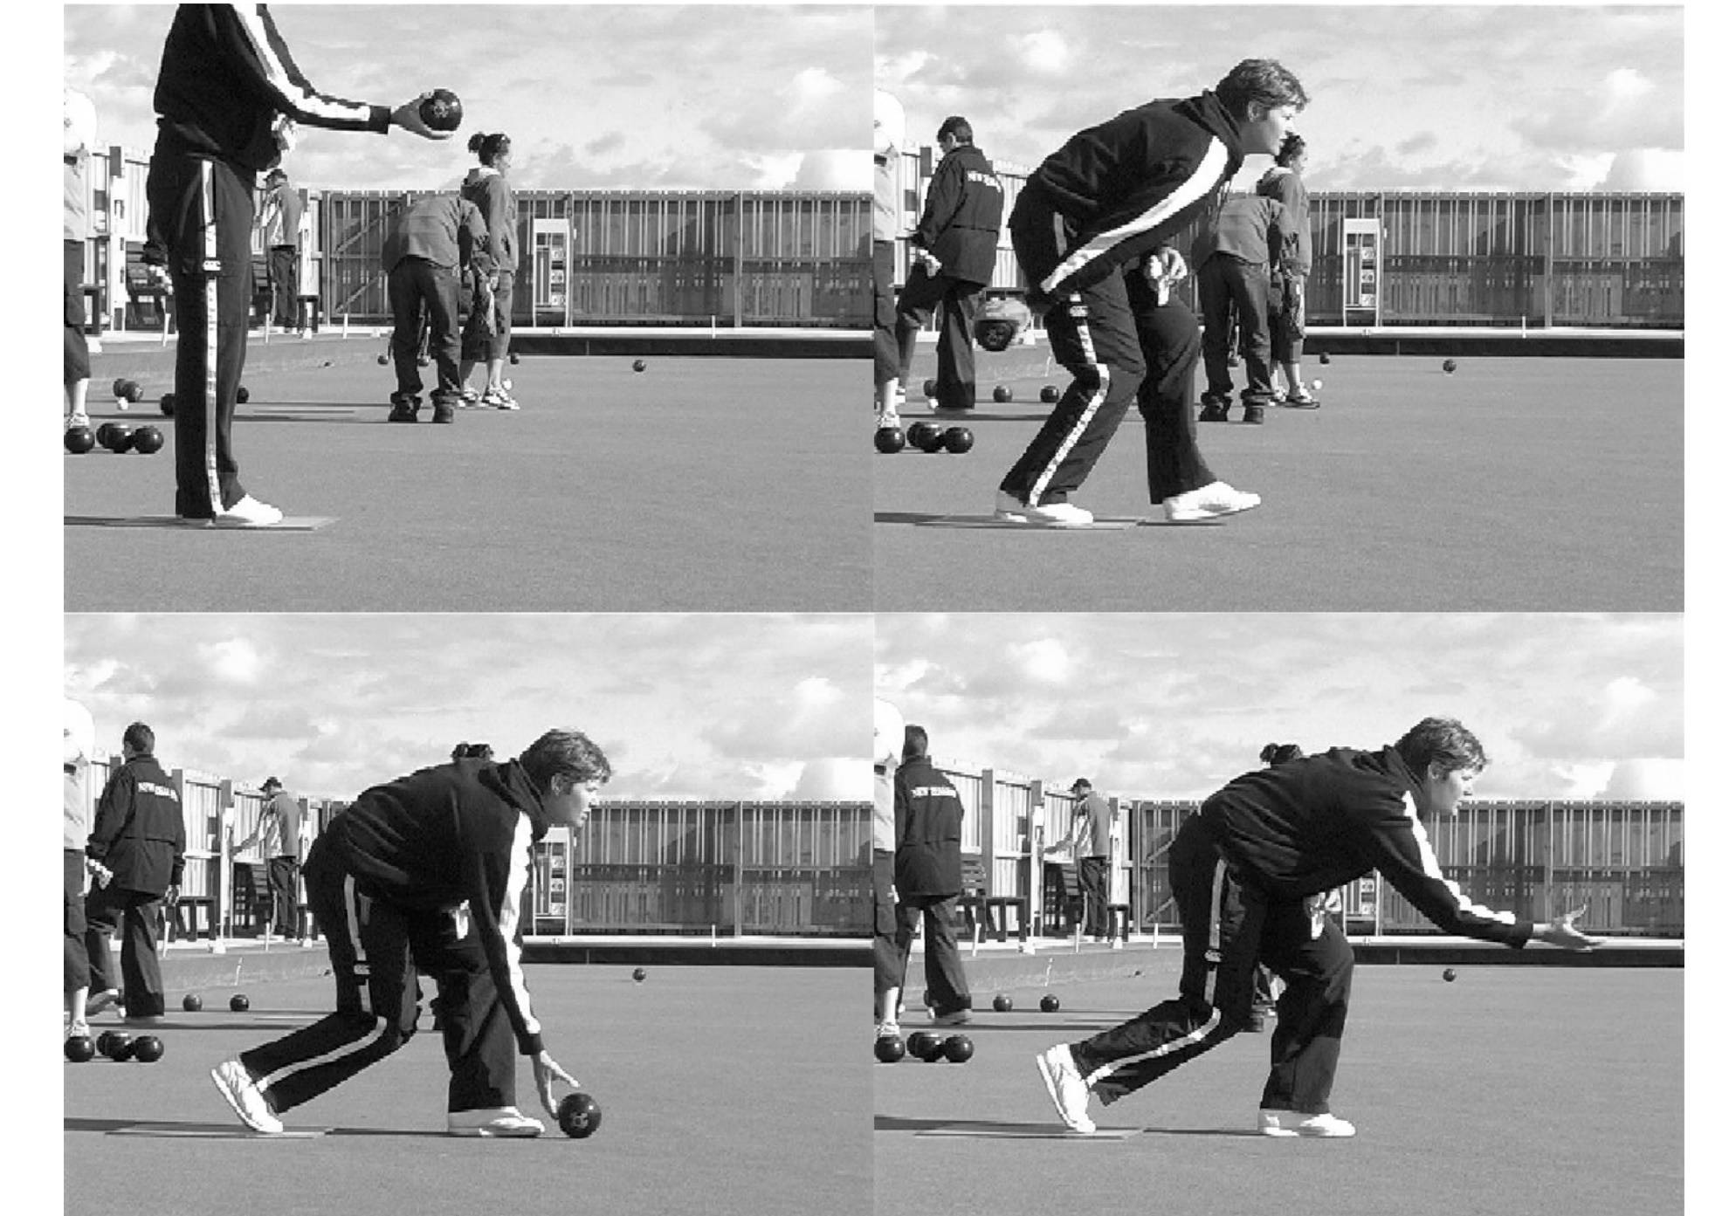
Antagonistic Joint Control
298mm
417mm

Slide 8
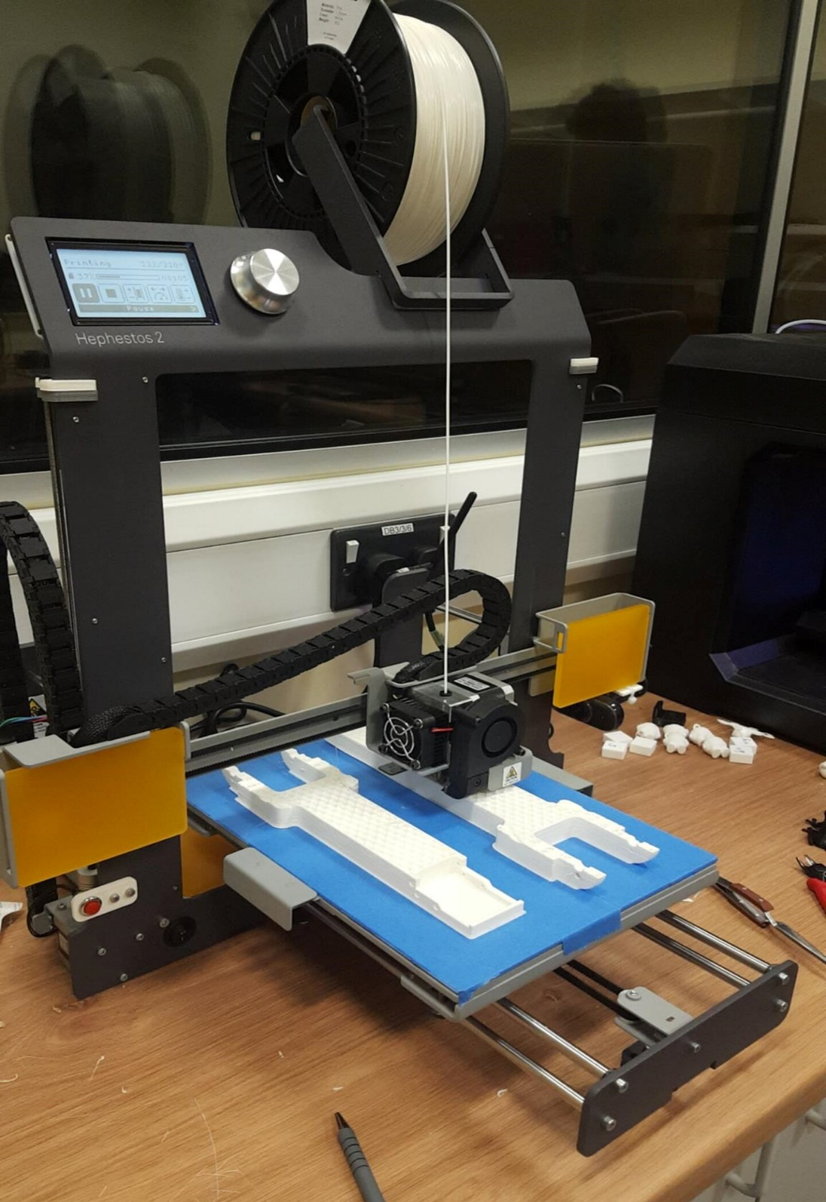
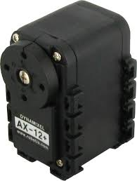

Hardware and software used/required
3D printed parts
3D Printers (Makerbot and Hephestos 2)
Cura
AutoDesk Fusion 360
LabView
3x AX-12 Servos and 2x MX-64T Servos for controlling the movement
2x AX-12 Servos as encoders in the shoulder and elbow joint

Slide 9
